Slide 1
Determination of ¹⁴C abundance in liquid scintillator
V. Sinev
INR RAS, Moscow Russia
In collaboration with
I. R. Barabanov, L. B. Bezrukov, A. V. Veresnikova, V. Yu. Grishina, V. I. Gurentsov, V. P. Zavarzina, S. D. Krokhaleva, A. S. Kurlovich, B. K. Lubsandorzhiev, S. B. Lubsandorzhiev, A. K. Mezhokh, G. Ya. Novikova, A. Yu. Sidorenkov, V. V. Sinev, E. A. Yanovich,
Yu. M. Gavrilyuk, A. M. Gangapshev, V. V. Kazalov, V. V. Kuz’minov, V. B. Petkov, A. M. Pshukov, Sh. I. Umerov
V. P. Morgalyuk
P. Yu. Naumov,
T. Enquist, P. Kuusiniemi, J. Joutsenvaara, A. Virkajarvi
INR RAS, Moscow
BNO INR RAS, Baksan
INEOS, Moscow,
MEPI, Moscow
Univ. Oulu, Finland
50-th Anniversary of Baksan Neutrino Observatory, Nalchik, June 6-8 2017

Slide 2
Plan
Introduction
Detector for liquid scintillator tests
Detector backgrounds
LAB measurements
Conclusion

Slide 3
Introduction
For large scintillation detectors the key problem is threshold, which is limited by the ¹⁴C contamination.
We decided to check the hypothesis that in coal solvent the abundance of ¹⁴C is less than in oil one.
For this purpose we have organized at Baksan NO the laboratory to measure samples of liquid scintillator to determine ¹⁴C abundance.

Slide 4
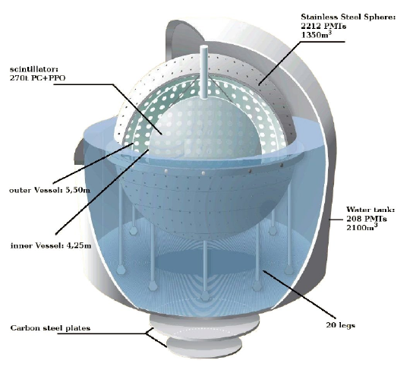
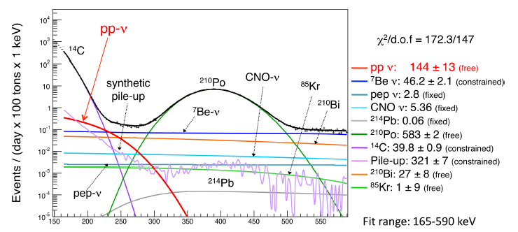
Borexino detector and ¹⁴C
Fiducial mass 100 t ,
Total 300 t

Slide 5
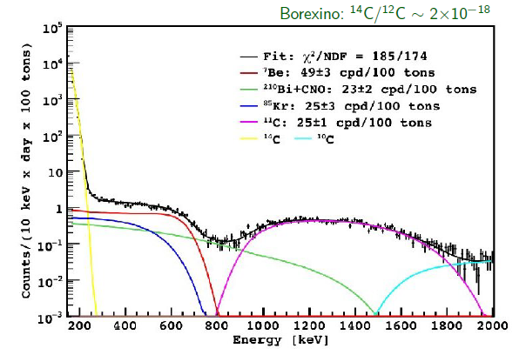
Borexino measured spectrum of recoil electrons

Slide 6
Recoil electrons spectrum from ⁴⁰K in BOREXINO

Slide 7
Setup for measuring abundance of 40K in small samples of liquid scintillator

Slide 8
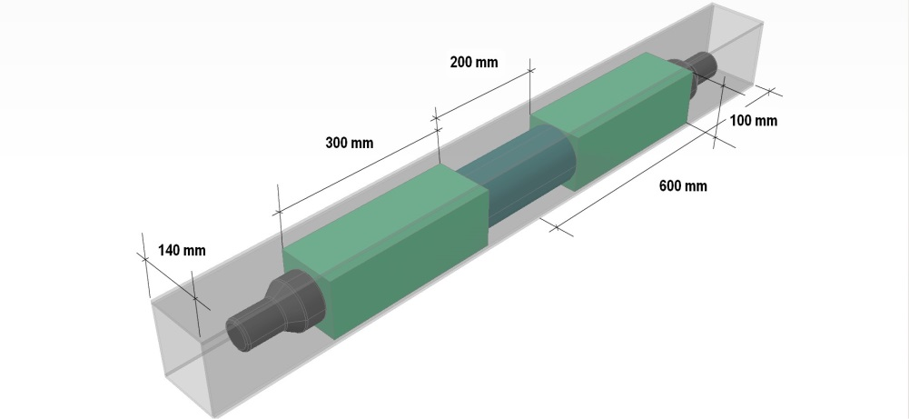
Detector
The cuvette filled with explored liquid
Light guide
Photo multiplier

Slide 9
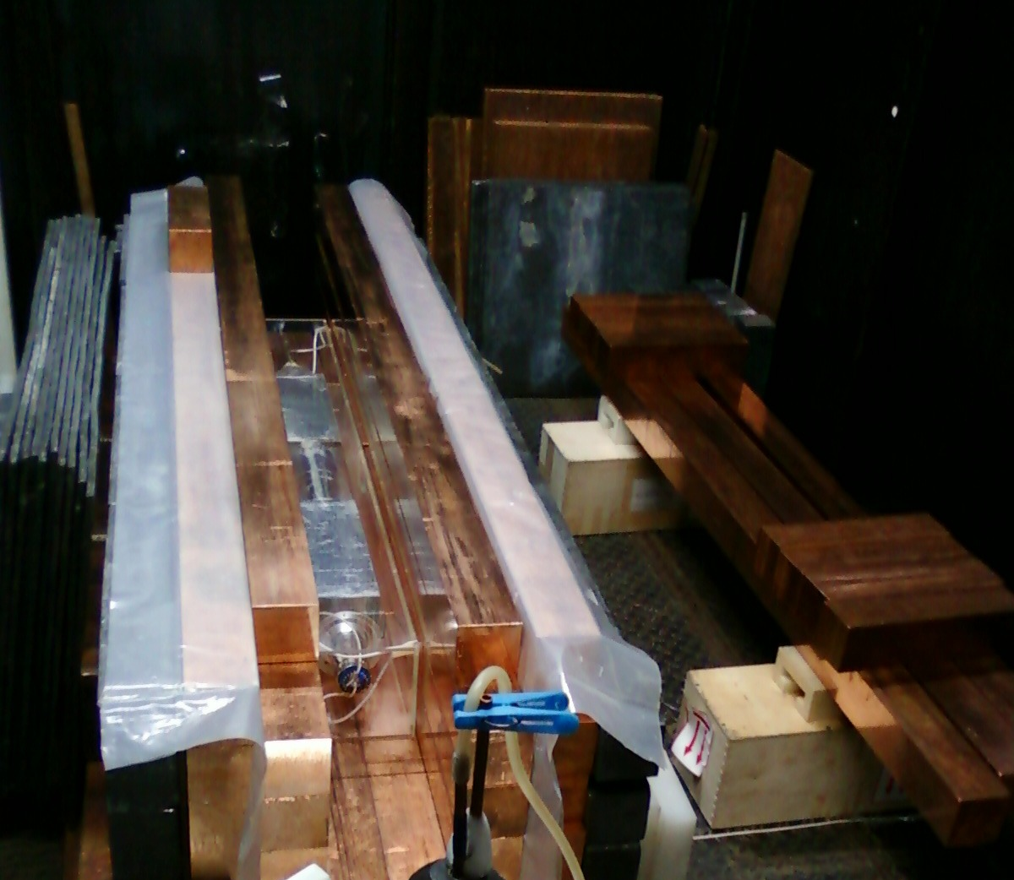

Slide 10
Scintillator on base of linear alkyl benzene (LAB)
LAB is a mixture of hydro carbonates with a formula like C_{n}H_{2n-6}. Density is between 0.855 and 0.858 g/cm³. Flash point is 143°C.
In our sample we have 4 fractions: C₁₆H₂₆(12.5%), C₁₇H₂₈(29.3%), C₁₈H₃₀(31.5%), C₁₉H₃₂(26.7%).
Light yield is about 8000 photons per MeV
Attenuation length at 420 nm 15 m.

Slide 11
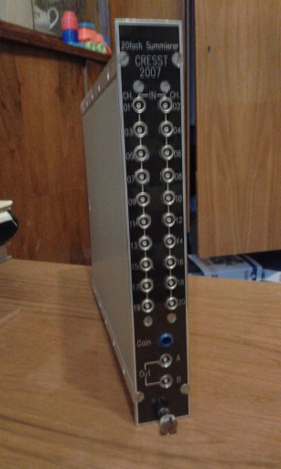
Used electronics
PMT 1
Trigger
Σ
PMT 2
A
Digital oscilloscope NI5015

Slide 12
Backgrounds
Uranium and thorium chains are not in equilibrium in cooper shielding and scintillator itself.
We regard the rest of uranium and thorium after purification and amount of their products after several years passed after purification.
Radon can penetrate in shielding gaps and in the scintillator volume.
Potassium-40 comes mainly from voltage dividers.
Cerenkov light emitting in light guides due to energetic gammas from shielding.

Slide 13
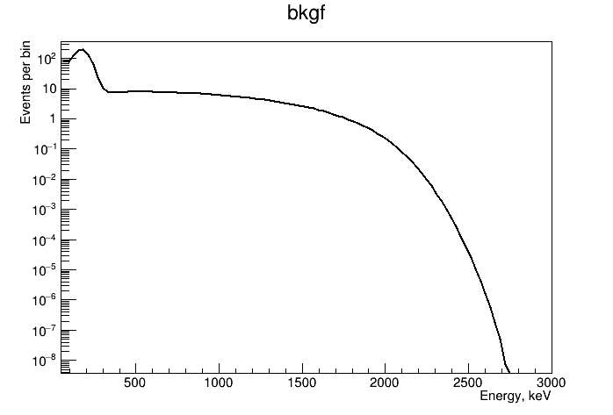
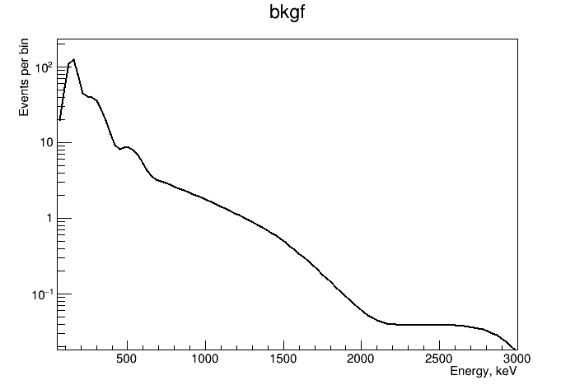
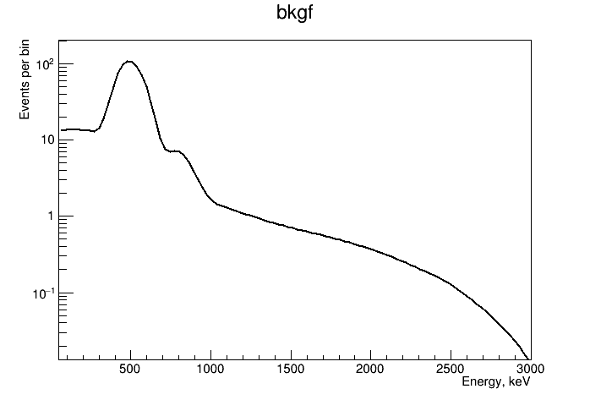
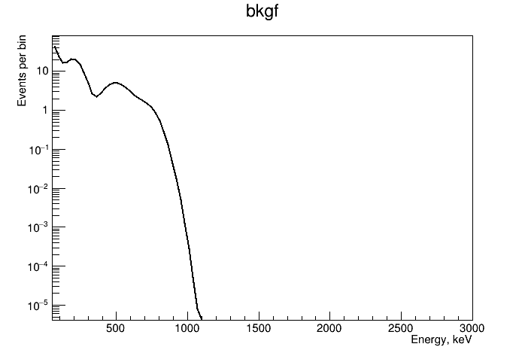
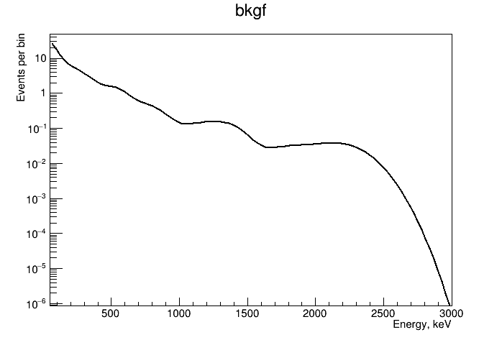
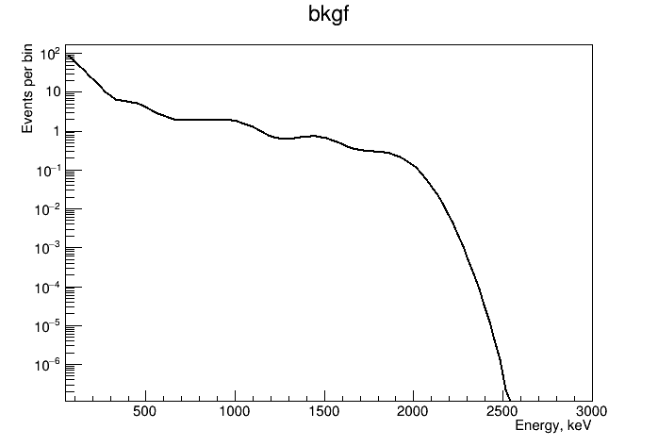
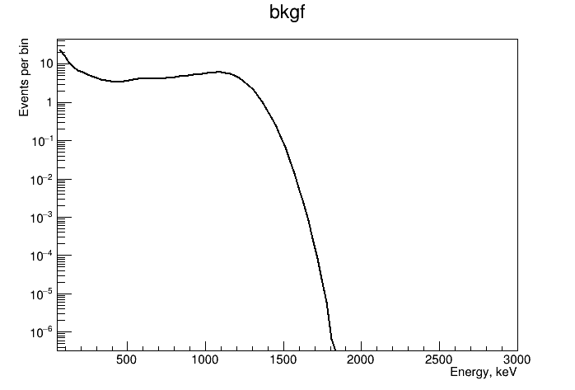
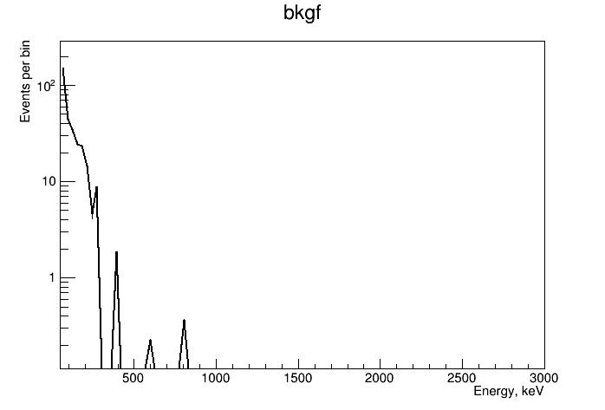
Backgound parts
²³²Th inside
²²²Rn inside
²³⁸U inside
²³⁸U outside
²³²Th outside
²²²Rn outside
⁴⁰K outside
Cerenkov light

Slide 14
Comparing of spectra from scintillator and from light guides and pmt glass.

Slide 15
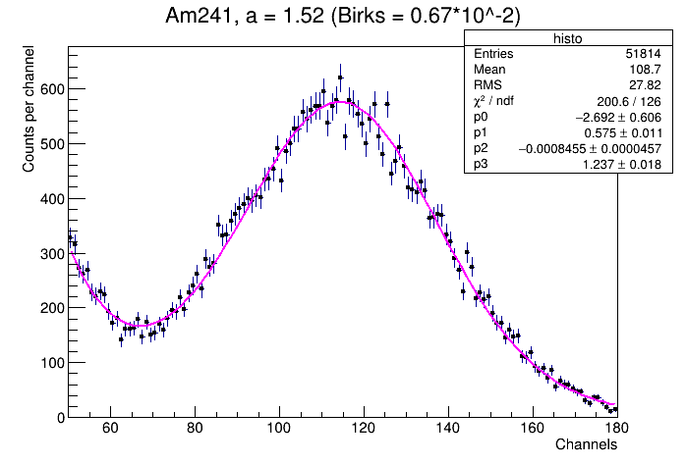
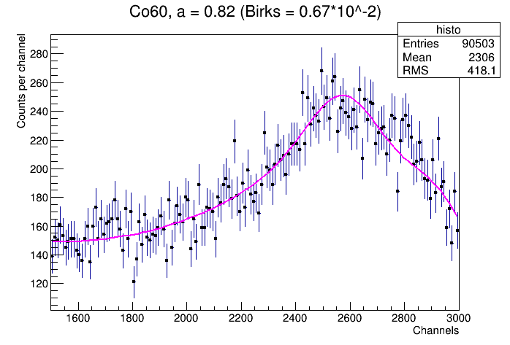
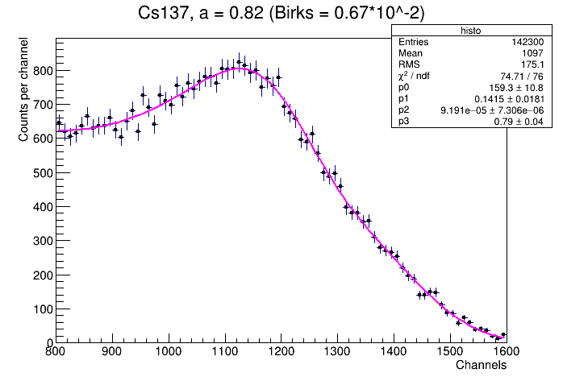
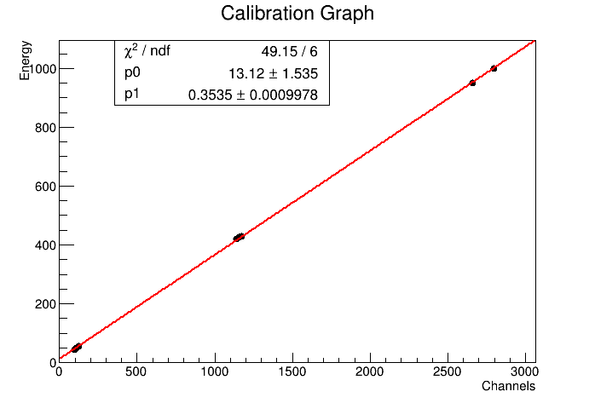
Calibration

Slide 16
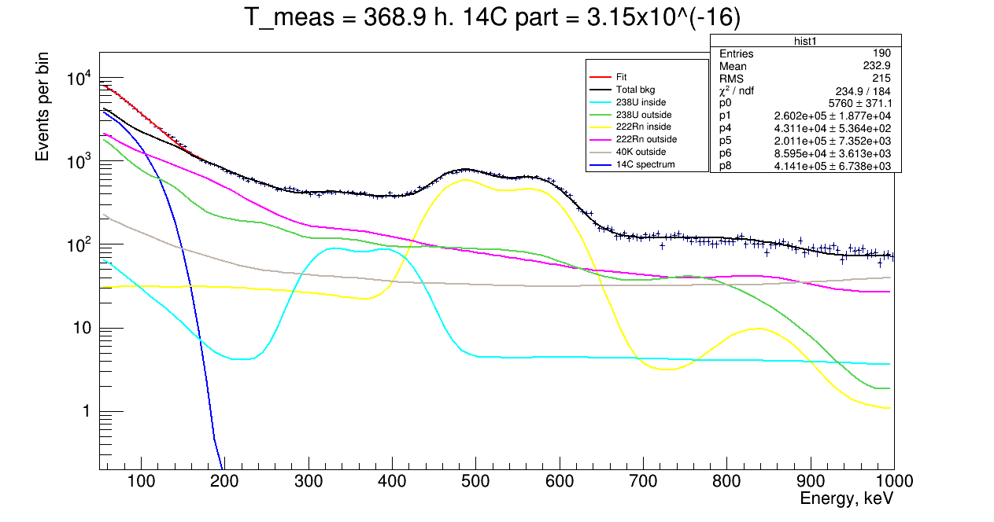
¹⁴C LAB sample measuring with ²²²Rn

Slide 17
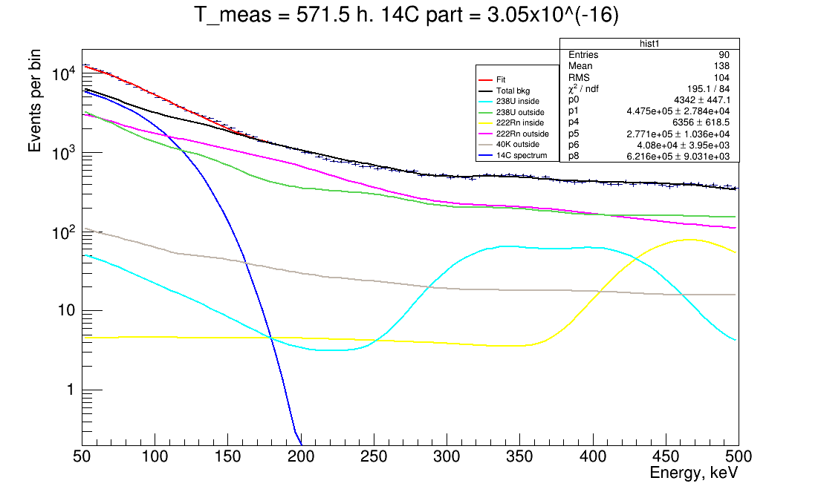
¹⁴C LAB sample measuring with ²²²Rn decayed

Slide 18
Conclusion
Low background setup placed at Baksan underground laboratory is available to start researches of scintillator samples
First measurements show backgrounds should be better depressed to see clearly ¹⁴C spectrum.
To the moment we began to understand the origin of backgrounds in our detector and started to simulate these backgrounds.
Measured ¹⁴C/¹²C ratio for the LAB (Russia, 2017) sample is (3.2 ± 1.1) × 10⁻¹⁶ and (5.5 ± 1.0) × 10⁻¹⁶ for LAB (China, 2017).

